Slide 1
The Title

Slide 2
Outline
Problem Statement
Existing Approaches & Comparison
Open Issues
Discussion & Outlook
Remember the main goal of this seminar:
How to do and present a systematic literature survey

Slide 3
Problem Statement
Example: How to utilize monitoring services to capture and analyze health and state of a Cloud application
…
Present the actual problem you are dealing with
Provide some motivation (e.g., real-world examples/use cases) to outline the relevance of this problem
Define key terms you are using to precisely set the scope and understanding of your work

Slide 4
Existing Approaches
Examples: CloudWatch, AzureWatch, CloudStatus, Monitis, Aneka, …
…
Analyze the State of the Art systematically to identify and explain existing approaches
Explain each approach shortly
Your literature survey may include scientific papers, books, articles, blog posts, etc.
You should define concrete criteria on which you focus when reviewing and analyzing existing approaches

Slide 5
Comparison
 | Aspect 1 | Aspect 2 | …
Approach A | … | … | …
Approach B | … | … | …
… | … | … | …
Systematically compare the existing approaches you identified before
Explicitly define the aspects your comparison is based on; you may derive these comparison aspects from the criteria
Use appropriate means to visualize the comparison such as a matrix

Slide 6
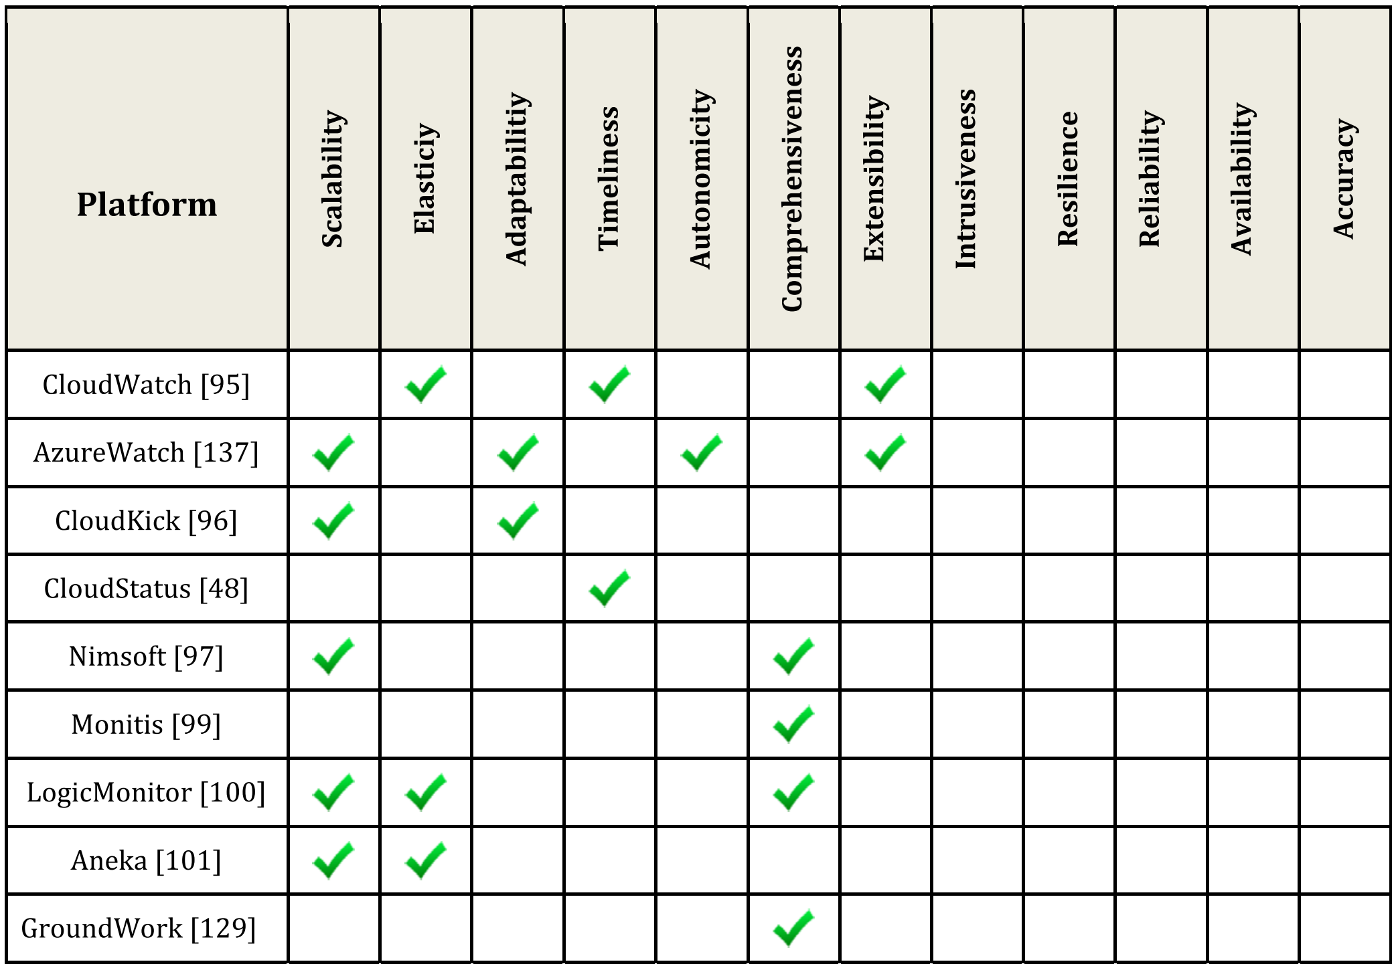
Comparison Example
?
?
?
?
Aceto et al.: Cloud Monitoring: A Survey, Computer Networks, 2013

Slide 7
Open Issues
Examples: cross-layer monitoring, cross-domain monitoring (federated Clouds, hybrid Clouds, multi-tenancy services), energy and cost efficient monitoring
…
What open issues do exist in terms of (partly) unsolved problems, and other deficiencies of the existing approaches?

Slide 8
Discussion & Outlook
…
What might be the reasons for the open issues?
What solution proposals can you make to improve the situation (State of the Art)?
What about combining some of the existing approaches to overcome open issues?
…

Slide 9
Thank you!

